Slide 1
SHARED
An international collaboration of viral sequences, treatment histories, and health outcomes related to the hepatitis C virus
Surveillance of Hepatitis-C Antiviral Resistance, Epidemiology and methoDologies
S.Fourati*, F. Ceccherini-Silberstein*, AYM Howe, VC Di Maio, A. de Salazar, S. Popping, ESE Tay, C. Rodrigo, E. Cunningham, M. Kjellin, J. Sfalcin, P. Gomes, M. Poljak, M. Lunar, M. Sayan, O. Mor, D. Salmon, R. Usubillaga, C. Seguin-Devaux, C. Boucher, L. Poiteau , A. Lloyd , J. Grebely, J. Lennerstrand, R. Kaiser, P. Zhigalkina, V. Chulanov, Miguel Garcia Deltoro, Joaquin Cabezas, Juan Carlos Alados, RJ de Knegt, M. Douglas, F. Garcia, R. Harrigan and JM Pawlotsky
On behalf of the contributing members of the SHARED database
HCV Resistance Patterns in a Worldwide Network of Cohorts of GT-3a infected patients

Slide 2
INTRODUCTION
HCV genotype 3 is the second most common genotype worldwide, estimated to affect 54 million people globally
When compared with other genotypes, HCV genotype 3 has been associated with
More rapid disease progression
More frequent development of steatosis and hepatocellular carcinoma (HCC)
Lower rates of response to DAA-based combinations, especially in patients with cirrhosis

Slide 3
INTRODUCTION
Depending on treatment history, the absence or presence of cirrhosis and the presence of RASs at baseline, therapies currently recommended by EASL and AASLD for the treatment of chronic HCV GT-3 include:
Glecaprevir/Pibrentasvir (G/P)
Sofosbuvir/Velpatasvir (SOF/VEL) ± ribavirin
Sofosbuvir/Velpatasvir/Voxilaprevir (SOF/VEL/VOX)
If these regimens are not available or not affordable, the combination of Sofosbuvir and Daclatasvir (SOF + DCV) ± ribavirin is an acceptable option

Slide 4
SHARED
An international collaboration of viral sequences, treatment histories, and health outcomes related to the hepatitis C virus
Surveillance of Hepatitis-C Antiviral Resistance, Epidemiology and MethoDologies
The reasons for the reduced efficacy of DAA therapies in GT-3a infections (including the impact of resistance patterns) remain unclear
OBJECTIVE
To investigate the frequency of the different resistance patterns in a large international cohort of DAA-naïve and –experienced patients with GT3a infection from a variety of countries and continents

Slide 5
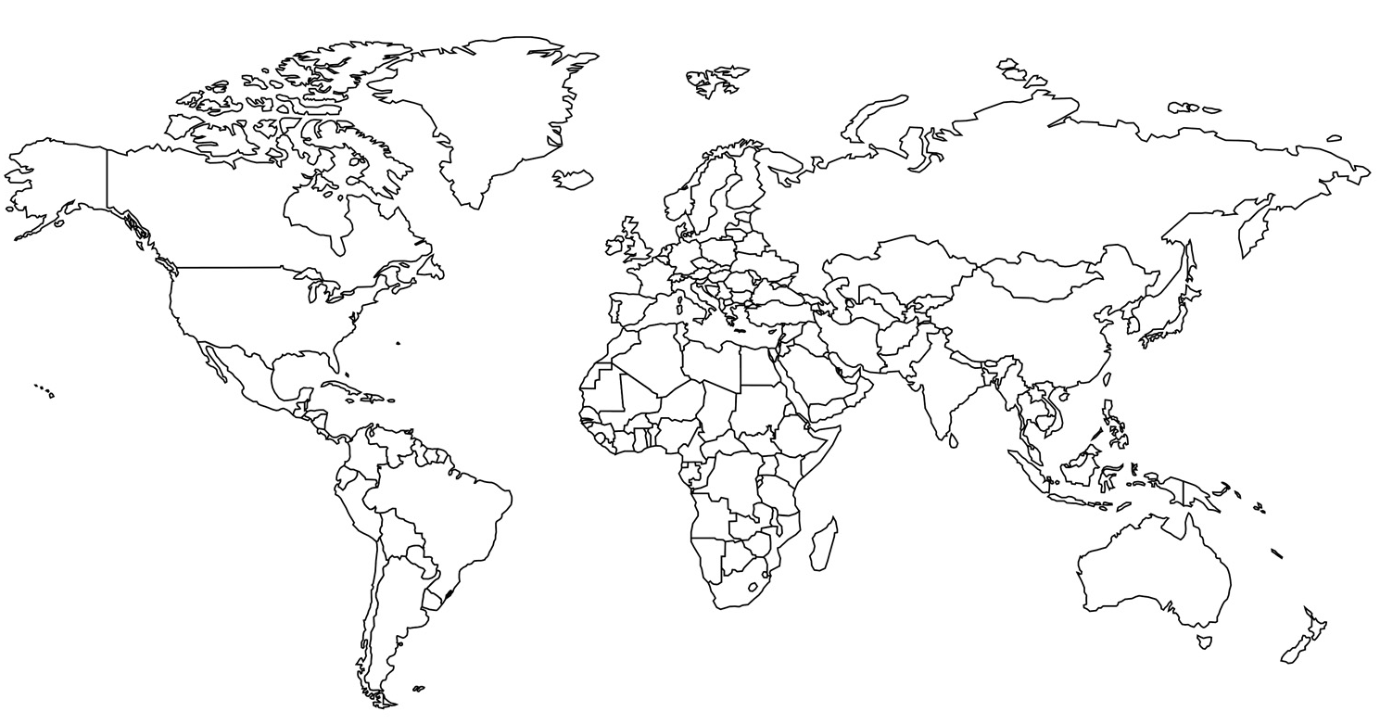
SHARED
An international collaboration of viral sequences, treatment histories, and health outcomes related to the hepatitis C virus
Surveillance of Hepatitis-C Antiviral Resistance, Epidemiology and MethoDologies
SHARED Participating Centers
2656 HCV (+) patients
(with NS5A sequences)
863 GT-3 patient sequences
351 DAA-naïve
384
DAA failures
430 Antiviral therapy failures
82 patients with insufficient data
46 Patients who failed non-indicated therapies, including
Peg-IFN, GZR/EBR, 3D, 2D, ± RBV

Slide 6
Patients and methods
Patients
Non-interventional epidemiological study
Clinical information: age, sex, cirrhosis status and prior treatment received, recorded in an anonymized submission database (SHARED).
Methods
NS5A ± NS3 protease ± NS5B polymerase sequencing
Sanger sequencing
Next-generation sequencing (15% cut-off)
Key RAS positions examined
NS5A region: S24, M28, A30, L31, P32, Q54, P58, E92, Y93
NS3 protease region: Y56, Q80, R155, A156, Q168
NS5B region: K100, A150, L159, G188, K206, T213, E237, N244, S282, C316, L320, V321

Slide 7
GT-3 Patient Characteristics
 | DAA-naïve patients (n=351) | Patients who failed DAAs (n=384) | P
Gender
Male | 269 (76.4%) | 321 (83.6%) | NS
Female | 80 (22.8%) | 61 (15.9%)
Unknown | 2 (0.6%) | 2 (0.5%)
Age
Median (range) | 52 (26-79) | 52 (19 – 75) | NS
Cirrhosis
Yes | 127 (36.2%) | 191 (49.7%) | <0.01
No | 111 (31.6%) | 78 (20.3%)
Unknown | 113 (32.2%) | 115 (29.9%)
DAA regimen that failed
SOF/VEL ± RBV | - | 41 (10.7%)
SOF + DCV ± RBV | - | 250 (65.1%)
SOF/LDV ± RBV | - | 51 (13.3%)
SOF/VEL/VOX ± RBV | - | 9 (2.3%)
G/P | - | 9 (2.3%)
Other combinations (SOF/RBV, SOF/PEG/RBV) | - | 24 (6.2%)

Slide 8
NS5A and NS3 RAS in DAA-naïve GT-3a patients
NS5A RAS
(N=351)
NS3 protease RAS
(N=152)
*including A30V/T + Y93H (n=2), P58T + Y93H (n=1)
**M28I/V (n=7), L31I (n=2), P58S/G/T (n=5)

Slide 9
NS5A RAS after SOF/NS5A inhibitor therapy failure
SOF/LDV ± RBV**
N=51
SOF + DCV ± RBV**
N=250
*L31I (n=2), A30S/V (n=2)
*L31F/I (n=4)
** with RBV (39%, n=20)
** with RBV (22%, n=55)

Slide 10
NS5A RAS combinations after SOF + DCV ± RBV failure
SOF + DCV ± RBV
N=250
Y93H + RAS
N=21
NS5A RAS (GT-3a) | Fold change (DCV)
A30K | 117
Y93H | 3733
A30K + Y93H | >10000
M28V + Y93H | 279
P58S + Y93H | 3430
Y93H + RAS
8%
Hernandez et al. (2013) J. Clin Virol 57;13-18; FDA Microbiology/Virology Review; Smith D et al. Hepatology. 2019 May;69(5):1861-1872

Slide 11
NS5A resistance profile after SOF/VEL failure
SOF/VEL ± RBV***
N=41
NS5A RAS (GT-3a) | Fold change (VEL)
Y93H | 724-733
M28V | 2.5
A30K | 50
A30S + Y93H | >100
A30K + Y93H | >10000
* M28V (n=1), S24A + A30T (n=1)
**including A30S + Y93H (n=3), A30K + Y93H (n=1), P58T + Y93H (n=1)
***with RBV (9.7%, n=4)
FDA Microbiology/Virology Reviews Epclusa; Smith D et al. Hepatology. 2019 May;69(5):1861-1872

Slide 12
NS5A and NS3 RAS after GLE/PIB failure

Slide 13
NS5A and NS3 RAS after GLE/PIB failure
GLE/PIB
n=9
NS5A
N=9
NS3
N=8
NS5A RAS (GT-3a) | Fold change (PIB)
A30K | 1.1
Y93H | 2.3
A30K + Y93H | 69
NS3 RAS (GT-3a) | Fold change (GLE)
A156G | 1500
Y56H + Q168R | 1100-1387
Krishnan P et al. 2017 J. Hepatol 66: S500; FDA Microbiology Review

Slide 14
NS5A and NS3 RAS after SOF/VEL/VOX failure
* with RBV (29%, n=2)

Slide 15
NS5A and NS3 RAS after SOF/VEL/VOX failure
SOF/VEL/VOX ± RBV
n=9
NS5A
NS3
n=9
n=9
NS5A RAS (GT-3a) | Fold change (VEL)
Y93H | 724-733
A30K | 50
A30K + Y93H | >10000
NS3 RAS (GT-3a) | Fold change (VOX)
Q168R | 9.4
Svory-Sobol H et al. 2017 AASLD; FDA Microbiology/Virology Reviews Epclusa; Smith D et al. Hepatology. 2019 May;69(5):1861-1872

Slide 16
GT-3a NS5B RASs after failure of SOF-based therapy compared to DAA-Naïve patients
DAA-naïve patients (n=142)
No single specific NS5B polymorphisms associated with SOF-containing regimen failures.
Patients who failed SOF-based therapy (n=356)
New polymorphism combinations in SOF-experienced patients ?
E237G + N244T (n=1)
A150V + T213N + N244D (n=1)
A150V + K206E + N244D (n=2 versus 1 in a SOF-naïve patient)

Slide 17
NS5A CONCLUSION
This study reports the prevalence of RASs in the largest network of worldwide cohorts of GT3a-infected patients from 17 countries
The prevalence of NS5A RAS at treatment baseline was 22%, in line with what has been reported in other studies
The vast majority of patients who failed to achieve SVR harbored resistant HCV variants carrying one or two NS5A RASs, the most frequent being Y93H
The frequency of the co-selection of Y93H with another RAS at position 30 (A30R/S/T, A30K) depended on the treatment regimen received (first- versus last-generation DAAs)
The A30K + Y93H conferred high-level resistance to all NS5A inhibitors, including Velpatasvir and Pibrentasvir

Slide 18
NS5B CONCLUSION
The selection of NS5B RASs by sofosbuvir is rare: S282C/T was found in only 1.6 % of patients failing a SOF-containing regimen
No single NS5B polymorphisms (including at newly reported positions 150 and 206) were associated with SOF-containing regimen failures. However, so far unknown polymorphism combinations were detected in SOF-experienced patients (phenotypic testing ongoing)

Slide 19
NS3 CONCLUSION
The high prevalence of multiple combination of NS3 RAS in patients failing Glecaprevir/Pibrentasvir was higher than expected, possibly due to short-time sampling after failure (EOT). These RASs are likely to disappear after a few months off treatment.

Slide 20
GENERAL CONCLUSION
In patients infected with GT-3, the presence of multiple NS3 and NS5A RAS is likely to challenge retreatment with combinations including last-generation inhibitors

Slide 21
Federico Garcia/A de Salazar. Instituto Investigación Biosanitaria Ibs., Granada, Spain
Ana Martínez-Sapiña. Hospital Miguel Servet.. Zaragoza; Spain
Carlos Galera. Hospital Reina Sofia. Murcia, Spain.
P Rincón. Hospital Universitario de Valme, Seville; Spain
Carole Seguin-Devaux. Luxembourg Institute of Health, Luxembourg
Francesca Ceccherini-Silberstein/CF Perno/VC Di Maio. University of Rome Tor Vergata, Rome, Italy
VIRONET
Orna Mor. Sheba Medical Center, Ramat-Gan, Israel
Christoph Sarrazin/Julia Dietz. University Hospital Frankfurt, Frankfurt, Germany
Rolf Kaiser/Elena Knops. University Hospital Cologne, Cologne, Germany
Vladimir Chulanov. Central Research Institute of Epidemiology, Russia
Mark Douglas. The Westmead Institute for Medical Research,
The University of Sydney, Australia
Tanya Applegate/Jason Grebely. The Kirby Institute, Sydney, Australia
Andrew Llyod/Chaturaka Rodrigo. University of New South Wales, New South Wales, Australia
Jean-Michel Pawlotsky/Stéphane Chevaliez/ Slim Fourati. Centre National de Réference des Hépatites B, C et delta, ANRS- Hepather
Dominique Salmon, Rafael Usubillaga. Paris Descartes University, FranceUniversity, Paris, France
Gary Wang/David Nelson/HCV TARGET. University of Florida College of Medicine, Gainesville, USA
J Sfalcin/Fabien Fay. Laboratorio CIBIC, Rosario, Argentina
Milosz Parczewski. Pomeranian Medical University, Szczecin, Poland
Mario Poljak/Maja Lunar. University of Ljubljana, Slovenia
Charles Boucher/Stephanie Popping/ Rob de Knegt. Erasmus Medical Center, Rotterdam, Netherlands
Johan Lennerstrand/Midori Kjellin. Uppsala University, Uppsala, Sweden
Perpetuua Gomes. Hospital Egas Moniz, Lisbon and CiiEM, Almada, Portugal
Murat Sayan. Kocaeli University Faculty of Medicine, Kocaeli, Turkey
Rohit Pai. Univeristy of Bristish Columbia, BC, Canada
Jordan Feld. Toronto General Hospital. ON, Canada
Alex Wong. University of Saskatchewan, SK, Canada
Samuel Lee. University of Calgary, AB, Canada
Alnoor Ramji, University of British Columbia, BC, Canada
Anita Howe/ Richard Harrigan/Hope Lapointe. University of British Columbia,BC, Canada
Naveed Janjua/Mel Krajden, BC-CDC, British Columbia, Canada
Edward Tam, LAIR Center, British Columbia, Canada
Cruz Pereira. University of British Columbia, BC, Canada

