Slide 1
SHARED
An international collaboration of viral sequences, treatment histories, and health outcomes related to the hepatitis C virus
Surveillance of Hepatitis-C Antiviral Resistance, Epidemiology and methoDologies
The global prevalence of resistance-associated substitutions (RAS) in “unusual” HCV subtypes
S. Popping*, S. Fourati* , AYM Howe , A. de Salazar, VC Di Maio, ESE Tay, C. Rodrigo, E. Cunningham, M. Kjellin, J. Sfalcin, P. Gomes, M. Poljak, M. Lunar, M. Sayan, O. Mor, D. Salmon, R. Usubillaga, C. Seguin-Devaux, A. Soulier , A. Lloyd , J. Grebely, J. Lennerstrand, R. Kaiser, P. Zhigalkina, V. Chulanov, RJ de Knegt, M. Douglas, F. Ceccherini-Silberstein, R. Harrigan, F. Garcia ,C. Boucher, JM Pawlotsky
On behalf of the contributing members of the SHARED database

Slide 2
INTRODUCTION
HCV is a highly diverse virus
8 genotypes
>100 subtypes
“Unusual” subtypes
GT1 non 1a/b,
GT2 non 2a/b,
GT3 non 3a
GT4 non 4a/d
GT5, GT6, GT-7 and GT-8
“Unusual” subtypes
Mostly originating from Africa and Asia
Multiple polymorphisms in NS5A
Lower SVR rates to NS5Ai-containing regimen
than “usual” subtypes
SM Borgia et al JID 2018; K Childs et al. J of Hepatol 2019; Wei et al. Lancet gastroenterol hepatol 2019; Gupta N et al. Lancet gastroenterol hepatol 2019

Slide 3
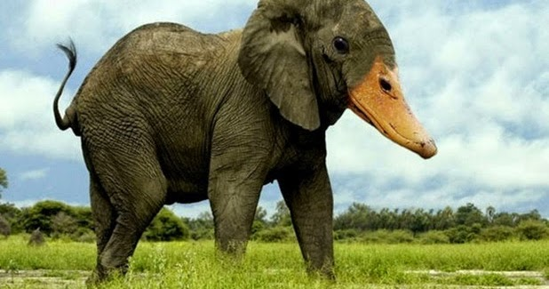
Aims of the study
To describe the prevalence of “unusual” subtypes among patients with NS5A inhibitor-based treatment failures
To characterize the RAS patterns selected in patients with “unusual” HCV subtypes

Slide 4
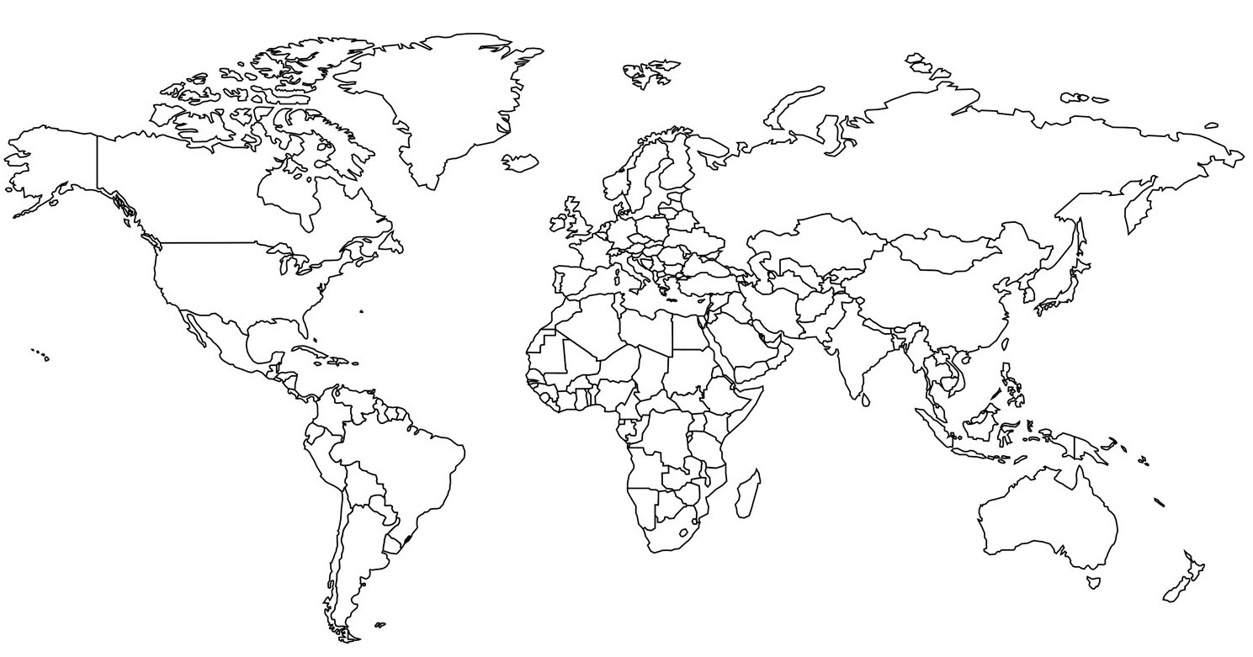
SHARED
An international collaboration of viral sequences, treatment histories, and health outcomes related to the hepatitis C virus
Surveillance of Hepatitis-C Antiviral Resistance, Epidemiology and MethoDologies
SHARED Participating Centers
2670 HCV (+) patients
(with ≥1 NS5A sequence)
1373 HCV (+) patients who failed a DAA treatment
74 patients with “unusual” subtypes who failed NS5A-inh based therapy
1176 patients who failed NS5A-inhibitor based therapy
197 patients with insufficient data or who failed PEG/RBV ± SOF or NS3 inhibitor (BOC or TVR, SIM)
1233 Patients who failed with a « usual » subtype

Slide 5
Patients and methods
Patients
Non-interventional epidemiological study
Clinical information: age, sex, cirrhosis status and prior treatment, recorded in an anonymized submission database (SHARED).
Methods
NS5A ± NS3 protease ± NS5B polymerase sequencing
Sanger sequencing
Next-generation sequencing (15% cut-off)
Genotype subtyping was performed after aligning HCV sequences by means of BLAST and performing phylogenetic analysis with reference sequences obtained from GenBank
RASs were analyzed at positions according to the 2018 EASL guidelines

Slide 6
Patient Characteristics
73 “unusual” subtypes from GT-1 to GT-6
 | Patients with “unusual” subtypes who failed DAAs (n=74)
Gender
Male | 46 (62%)
Female | 28 (38%)
Age
Median (range) | 59 (25-86)
Cirrhosis
Yes | 20 (27%)
No | 19 (26%)
Unknown | 35 (47%)
Prior treatment History
Treatment-naïve | 38 (51%)
Treatment-experienced | 20 (30%)
Unknown | 16 (19%)
DAA regimen that failed
SOF/LDV +/- RBV | 18 (24%)
SOF + DCV +/- RBV | 15 (20%)
SOF/VEL +/- RBV | 13 (18%)
GZR+EBR | 11 (15%)
2D/3D +/- RBV | 11 (15%)
G/P | 5 (7%)
Other (SIM+DCV+RBV) | 1 (1%)

Slide 7
Countries where the diagnosis of “unusual” subtype has been performed
Sweden (n=1)
Netherlands (n=1)
France (n=33)
Spain (n=1)
Italy (n=26)
Australia (n=12)
GT-2c
GT-3b
GT-1g
GT-2i/2j
GT-3g
GT-4r
GT-6q
GT-1l
GT-2q
GT-3h
GT-4 other
GT-6 other
GT-3k

Slide 8
GT-1 “unusual” ST have specific NS5A RAS patterns
“Unusual” GT-1 (n=7)
GT-1a used as a reference sequence

Slide 9
GT-1 “unusual” ST have specific NS5A RAS patterns
“Unusual” GT-1 (n=7)
GT-1a used as a reference sequence

Slide 10
GT-2 “unusual” ST have specific NS5A RAS patterns
“Unusual” GT-2 (n=12)
GT-2a used as a reference sequence

Slide 11
GT-2 “unusual” ST have specific NS5A RAS patterns
“Unusual” GT-2 (n=12)
GT-2a used as a reference sequence

Slide 12
GT-2 “unusual” ST have specific NS5A RAS patterns
“Unusual” GT-2 (n=12)
- NS3 seq (n=4) in patients failing NS3 inh:
. GT-2c: NS3 D168V (50%)
GT-2a used as a reference sequence

Slide 13
GT-3 “unusual“ ST have specific multiple NS5A RAS
“Unusual” GT-3 (n=16)
GT-3a used as a reference sequence

Slide 14
GT-3 “unusual“ ST have specific multiple NS5A RAS
“Unusual” GT-3 (n=16)
GT-3a used as a reference sequence

Slide 15
GT-3 “unusual“ ST have specific multiple NS5A RAS
“Unusual” GT-3 (n=16)
GT-3a used as a reference sequence

Slide 16
GT-4r NS5A RAS combinations are dominant
“Unusual” GT-4 (n=30)
GT-4a used as a reference sequence

Slide 17
GT-4r NS5A RAS combinations are dominant
“Unusual” GT-4 (n=30)
NS3 seq (n=8) in patients failing NS3 inh:
-GT-4g failed GZR/EBR (n=2; 100%) with NS3 R155Q + 156T + D168N or D168E
-GT-4r failed GZR/EBR (n=1; 25%) with Q80R + D168E
-Other subtypes: no NS3 RAS
GT-4a used as a reference sequence

Slide 18
GT-6 NS5A RAS combinations are frequent
“Unusual” GT-6 (n=8)
GT-6a used as a reference sequence

Slide 19
GT-6 NS5A RAS combinations are frequent
“Unusual” GT-6 (n=8)
NS5A:
-L28A + R30A/S: high-level in vitro resistance*
NS3: GT-6q
-G/P failure (n=1, 100%) : A156F + D168V
-GZR/EBR failure (n=1, 50%): Y56H + D168V
GT-6a used as a reference sequence
*McPhee et al. AAC 2019

Slide 20
CONCLUSION
Using the international SHARED network, we identified 74 patients infected with “unusual” HCV subtypes who failed to respond to an NS5A-containing DAA treatment
Our results confirm that subtypes GT-1l, GT-3b, GT-3g and GT-4r carry high-level resistance, responsible for the low SVR rates described in previous studies.
We identified other “unusual” HCV subtypes that are highly resistant to HCV DAAs:
GT-3k (multiple NS5A RASs: S24G ± M28L + A30K + L31M + E62L ± Y93H)
GT-4g (multiple NS3 RAS: R155Q + A156T + D168N) and GT-6q (multiple NS3 RAS: A156F + D168V)
The study impact on HCV DAA susceptibility are ongoing by means of phenotypic assays
In-depth epidemiological studies are required in Africa and Asia where these subtypes are more common, as well as in countries of immigration from these regions, in order to tailor future therapeutic strategies to their actual prevalence (possibly first-line triple therapy)

Slide 21
Federico Garcia/A de Salazar. Instituto Investigación Biosanitaria Ibs., Granada, Spain
Ana Martínez-Sapiña. Hospital Miguel Servet.. Zaragoza; Spain
Carlos Galera. Hospital Reina Sofia. Murcia, Spain.
P Rincón. Hospital Universitario de Valme, Seville; Spain
Carole Seguin-Devaux. Luxembourg Institute of Health, Luxembourg
Francesca Ceccherini-Silberstein/CF Perno/VC Di Maio. University of Rome Tor Vergata, Rome, Italy
VIRONET
Orna Mor. Sheba Medical Center, Ramat-Gan, Israel
Christoph Sarrazin/Julia Dietz. University Hospital Frankfurt, Frankfurt, Germany
Rolf Kaiser/Elena Knops. University Hospital Cologne, Cologne, Germany
Vladimir Chulanov. Central Research Institute of Epidemiology, Russia
Mark Douglas. The Westmead Institute for Medical Research,
The University of Sydney, Australia
Tanya Applegate/Jason Grebely. The Kirby Institute, Sydney, Australia
Andrew Llyod/Chaturaka Rodrigo. University of New South Wales, New South Wales, Australia
Jean-Michel Pawlotsky/Stéphane Chevaliez/ Slim Fourati. Centre National de Réference des Hépatites B, C et delta, ANRS- Hepather
Dominique Salmon, Rafael Usubillaga. Paris Descartes University, FranceUniversity, Paris, France
Gary Wang/David Nelson/HCV TARGET. University of Florida College of Medicine, Gainesville, USA
J Sfalcin/Fabien Fay. Laboratorio CIBIC, Rosario, Argentina
Milosz Parczewski. Pomeranian Medical University, Szczecin, Poland
Mario Poljak/Maja Lunar. University of Ljubljana, Slovenia
Charles Boucher/Stephanie Popping/ Rob de Knegt. Erasmus Medical Center, Rotterdam, Netherlands
Johan Lennerstrand/Midori Kjellin. Uppsala University, Uppsala, Sweden
Perpetuua Gomes. Hospital Egas Moniz, Lisbon and CiiEM, Almada, Portugal
Murat Sayan. Kocaeli University Faculty of Medicine, Kocaeli, Turkey
Rohit Pai. Univeristy of Bristish Columbia, BC, Canada
Jordan Feld. Toronto General Hospital. ON, Canada
Alex Wong. University of Saskatchewan, SK, Canada
Samuel Lee. University of Calgary, AB, Canada
Alnoor Ramji, University of British Columbia, BC, Canada
Anita Howe/ Richard Harrigan/Hope Lapointe. University of British Columbia,BC, Canada
Naveed Janjua/Mel Krajden, BC-CDC, British Columbia, Canada
Edward Tam, LAIR Center, British Columbia, Canada
Cruz Pereira. University of British Columbia, BC, Canada

