Slide 1
SHARED
An international collaboration of viral sequences, treatment histories, and health outcomes related to the hepatitis C virus
Surveillance of Hepatitis-C Antiviral Resistance, Epidemiology and methoDologies
A REAL WORLD RESISTANCE PROFILE OF VIROLOGIC FAILURES COLLECTED FROM AN INTERNATIONAL COLLABORATION (SHARED)
Anita Howe, Ph.D.
on behalf of SHARED

Slide 2
ACKNOWLEDGEMENTS
SHARED
Valeria Cento. Università degli Studi di Milano. Milano, Italy
Federico Garcia/A de Salazar. Instituto Investigación Biosanitaria Ibs., Granada, Spain
Francesca Ceccherini-Silberstein/CF Perno/VC Di Maio. University of Rome Tor Vergata, Rome, Italy
Christoph Sarrazin/Julia Dietz. University Hospital Frankfurt, Frankfurt, Germany
Jean-Michel Pawlotsky/Slim Fourati. Centre National de Réference des Hépatites B, C et delta, Créteil, France
Charles Boucher/Stephanie Popping. Erasmus Medical Center, Rotterdam, Netherlands
Rolf Kaiser/Elena Knops. University Hospital Cologne, Cologne, Germany
Johan Lennerstrand/Midori Kjellin. Uppsala University, Uppsala, Sweden
Tore Gutteberg/Hege Kileng. Tromsö University Hospital, Tromsö, Norway
Murat Sayan. Kocaeli University Faculty of Medicine, Kocaeli, Turkey
Orna Mor. Sheba Medical Center, Ramat-Gan, Israel
RJ de Knegt. University Medical Center, Rotterdam, the Netherlands
Gary Wang/David Nelson/HCV TARGET. University of Florida College of Medicine, Gainesville, USA
Milosz Parczewski. Pomeranian Medical University, Szczecin, Poland
Tanya Applegate/Jason Grebely. The Kirby Institute, UNSW, Sydney, Australia
Alnoor Ramji/Robert Mitchell. University of British Columbia, Vancouver, Canada
Edward Tam. LAIR Centre, Vancouver, British Columbia, Canada
Alex Wong. University of Saskatchewan, Saskatchewan, Canada
Rohit Pai/Oscar Pereira. Island Health, Victoria, British Columbia, Canada
Jordan Feld. Toronto Western Hospital Liver Center, Toronto, Canada
Nathaniel Knight, British Columbia Centre for Excellence in HIV/AIDS, British Columbia, Canada
Richard Harrigan. University of British Columbia, British Columbia, Canada
This project is funded by Genome British Columbia, Canada, and British Columbia Centre for Excellence in HIV/AIDS, Canada

Slide 3
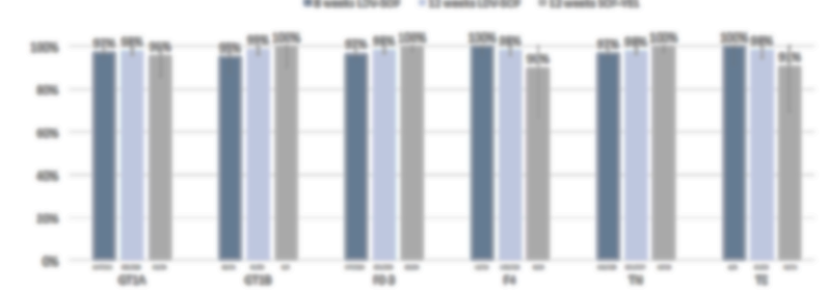
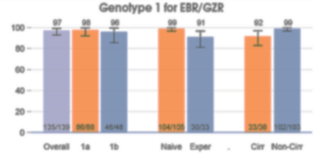
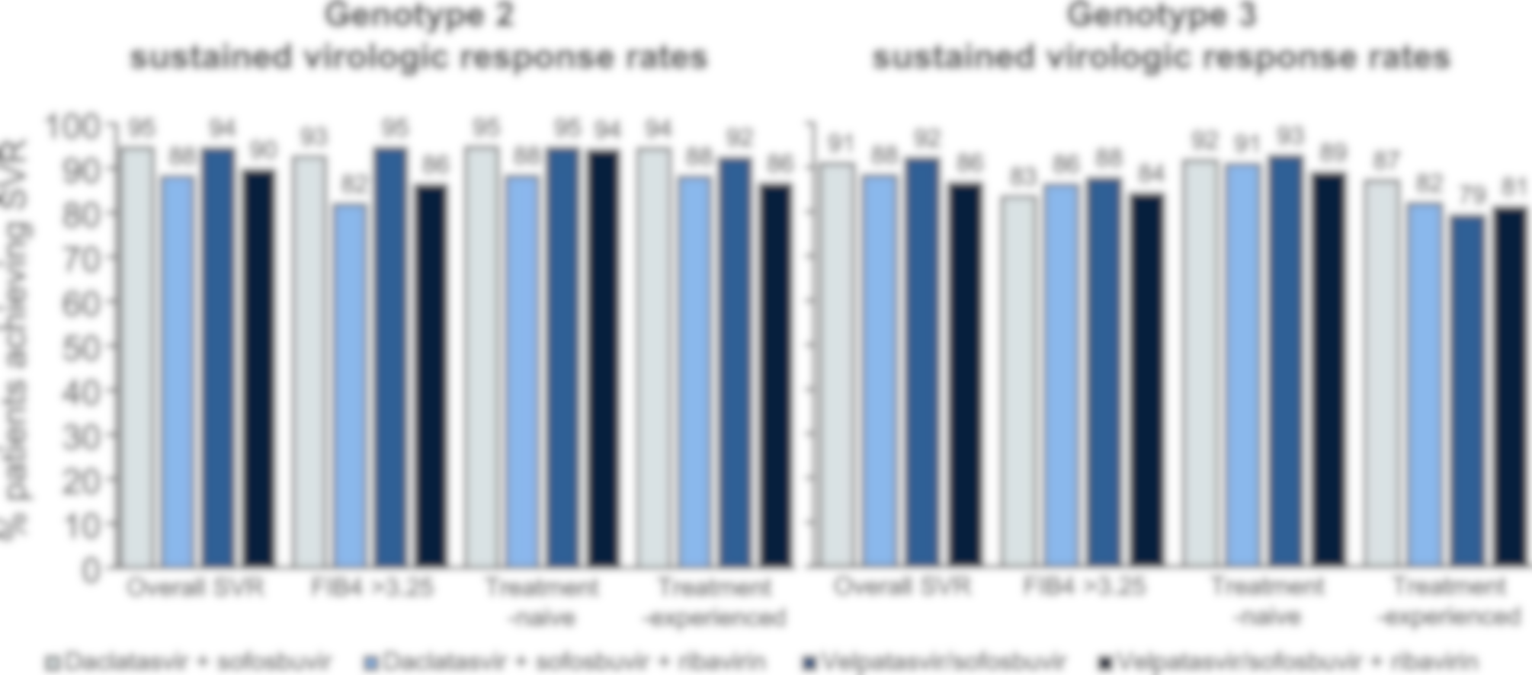
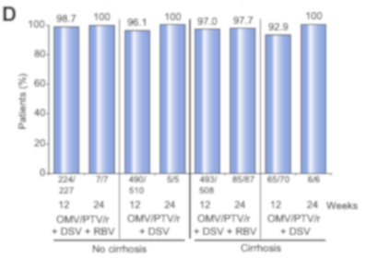
Direct-Acting Antivirals (DAA) provide >95% SVR
SHARED
1
2
With 71 million HCV infected patients worldwide, this translates into ~3 million virologic failures.
3
4
1
Pearlman BL et al. EASL 2017
Tsai, N et al. EASL 2017
Belperio PS et al. J. Hepatology 2018
Calleja JL Et al., J. Hepatology 2017;66:1138-48.

Slide 4
SHARED
An international collaboration of viral sequences, treatment histories, and health outcomes related to the hepatitis C virus
Surveillance of Hepatitis-C Antiviral Resistance, Epidemiology and MethoDologies
Resistance is frequent in virologic failures
Single center approaches not sufficient
OBJECTIVES – a global resource to
Characterize resistance-associated substitutions (RAS) in DAA failures
Develop resistance interpretation algorithm
Characterize rare genotypes
Provide relevant protocols, software, and literature

Slide 5
METHOD
SHARED
Sequences & associated data from 13 participating countries
Consensus amino acid sequences generated with modified NucAmino program adapted from HIV¹.
cut-offs for variant mixes: 15-20% for Population Sequencing, and 5% for Next Generation Sequencing.
Variants within NS3, NS5A, and NS5B as per 2018 EASL guidelines.
NS3: 36, 41, 43, 54, 55, 56, 80, 122, 155, 156, 158, 168, 170
NS5A: 24, 26, 28, 29, 30, 31, 32, 38, 58, 62, 92, 93
NS5B (sofosbuvir): 159, 282, 314, 316, 320, 321 and
NS5B (dasabuvir): 316, 368, 411, 414, 445, 448, 451, 553, 554, 555, 556, 557, 558, 559, 561, 565
1. Tzou et al. (2017) BMC bioinformatics 18:138

Slide 6
Characteristics OF N=748 Virologic failures
SHARED
Gender
Male | 564 (75%)
Female | 166 (22%)
Unknown | 18 (2%)
Age
Median (range) | 59 (22 – 87)
Genotype
GT 1a and others | 292 (39%)
GT 1b | 252 (34%)
GT 2 | 18 (2%)
GT 3 | 97 (13%)
GT 4 | 86 (11%)
GT 6 | 3 (0.4%)
Cirrhosis Status
Yes | 300 (40%)
No | 217 (29%)
Unknown | 231 (31%)
Treatment History
Treatment Naïve | 271 (36%)
Treatment Experienced* | 230 (31%)
Unknown | 247 (33%)
Cohort Characteristics
Number of Virologic Failures
* >80% failed pegylated Interferon/ribavirin

Slide 7
NS5A Mutations ARE very Common with NS5AIs
SHARED
560 subjects were treated with NS5AI-based regimens
87%
Number of RAS after treatment vs. Baseline | Number of Virologic Failures (n = 66^)
More # RAS | 32 (48%)
Same # RAS | 28 (42%)
Fewer # RAS | 6 (9%)
^patients with paired baseline and follow-up sequences.
Percentage of Virologic Failures
35%
31%
13%
11%
3%
3%
3%
NS5A gene

Slide 8
RAS selection almost certain after PI+NS5AI failure
SHARED
232 patients were treated with PI-containing regimens
76%
101 patients were treated with PI + NS5AI regimens
24%
NS3 Gene

Slide 9
RAS Patterns are distinct among genotypes; many are prevalent in natural isolates
SHARED
Virologic Failure with Detectable RAS
*
62E
30R
28M
24S
31M
*
Hatched bars = variants existed in >10% natural isolates.
Amino acid in red have reduced drug susceptibility in vitro
NS5A Amino Acid Position
<2% in positions 26, 29, 32, 38
* polymorphic

Slide 10
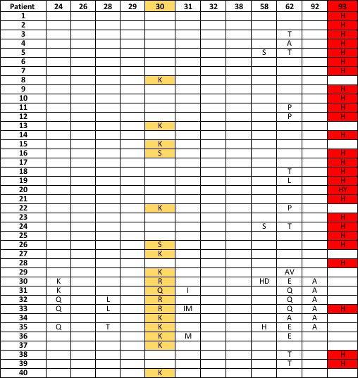
Distinct Pathways to Resistance in GT3
SHARED
An excerpt of GT3 DAA failures
 | Y93H Absent | Y93H Present | Total
A30any Absent | 24 | 56 | 80
A30any Present | 15 | 7 | 22
Total | 39 | 63 | 102
P = 0.001
 | Y93H Absent | Y93H Present | Total
A30K Absent | 24 | 52 | 76
A30K Present | 12 | 0 | 12
Total | 36 | 52 | 88
P < 0.0001
Y93H rarely paired with A30 mutations, and never with A30K

Slide 11
New NS5A RAS observed in “Real-world” data
SHARED
RAS Not Listed
 | NS5A RAS not listed in the 2018 EASL Guidelines
 | 24 | 26 | 28 | 29 | 30 | 31 | 32 | 38 | 58 | 62 | 92 | 93
1a/1/1d | Q/S | Q/R | L/T |  | A | M |  | H | C/G/H/D/L/P/N/Q/Y | A/D/G/Q/S/T | E
1b | R/S |  |  |  | A |  |  | A |  | L/R/T | E
2 | S^ |  |  |  |  |  |  |  |  | D/S
3 | K/Q/T |  | L/V |  | H/Q/R |  |  |  | H/D/Q/R/S | A/E/I/L/M/P/Q/T^/S^/V | A
4 | Q | R | M^/T |  | C/F/Q/R^/S | L/V |  |  | A/T | A/E^/N/Q/R/T |  | C
6 | K^ |  | M |  | Q |  |  |  | H | E |  | Y
^these variants are present in >10% natural isolates

Slide 12
Rare Genotypes Tend to select multiple NS5A RAS after DAA failure
SHARED
Genotype/Subtype | No. of Patients*
1e | 1
1g | 2
2c | 4
2i | 1
3b | 1
4b | 1
4c | 1
4d | 18
4g | 1
4o | 1
4r | 4
Genotype subtypes were derived from HCV sequence by BLAST and phylogenetic analysis with reference sequences obtained from GenBank
*Patients were treated with OMB-, LDV-, EBR-, or DCV-containing regimens
NS5A RAS
Note: Some WT GT4 subtypes have diverse amino acids. The impact of resistance remains to be determined.

Slide 13
High Frequency of S282T mutation in GT4 failures
SHARED
526 patients received sofosbuvir-based regimens: 179 GT1a/1d, 198 GT1b, 12 GT2, 104 GT3, 31 GT4, 2 GT6
NS5B S282T rarely detected during clinical development.
S282T confers 2- to 18- fold reduced drug susceptibility to sofosbuvir in HCV replicons.
23% of all GT4 patients selected S282T mutation after failing sofosbuvir-containing regimens.
% Virologic Failures with RAS in respective genotypes
*
NS5B Amino Acid
*3 patients had WST in the Sanger consensus sequence

Slide 14
No significant difference in NS5A RAS frequency in different patient groups
SHARED
182/217
149/174
130/150
358/402
39/46
165/187
39/49
163/192
198/218
6/6
5/5
8/13
P < 0.05
68/75
Percentage Virologic Failures with Detectable RAS

Slide 15
Conclusions
SHARED
Through international collaborations, SHARED provides an opportunity to conduct in-depth analyses for HCV drug resistance.
80-90% of the DAA-failures have selected resistant viruses.
RAS patterns are unique among genotypes; many RAS are prevalent in natural isolates.
New RAS were observed in real-world clinics.
“Rare genotypes” tend to select multiple RAS
20% of the genotype 4 patients selected NS5B S282T after failing sofosbuvir-containing regimens
Resistance data from non-GT1 and re-treatment are much needed!
Interested to join SHARED? http://hcvdb.ubc.ca

