Slide 1
Virological characterization of patients with CHC and failure to a glecaprevir/pibrentasvir or voxilaprevir/velpatasvir/sofosbuvir treatment in the international SHARED collaboration
Adolfo de Salazar¹, Julia Dietz², Velia Chiara Di Maio³, Slim Fourati⁴, Beat Müllhaupt⁵, Stefania Paolucci⁶, Joaquin Cabezas⁷, Rudolf E. Stauber⁸, Nicola Coppola⁹, Juan Arenas¹⁰, Christiana Graf², Miguel Jiménez-Pérez¹¹, Elisabetta Degasperi¹², Juan Manuel Pascasio¹³, Maria Paola Callegaro¹⁴, Johannes Vermehren², Jose Miguel Rosales Zabal¹⁵, Giovanni Battista Gaeta⁹, Miguel Garcia-Deltoro¹⁶, Heinz Zoller¹⁷, Massimo Puoti¹⁸, Christoph Berg¹⁹, Mark Douglas²⁰, Jean-Michel Pawlotsky⁴, Anita Howe²¹, Federico Garcia Garcia¹, Francesca Ceccherini Silberstein³, Christoph Sarrazin² ²²
¹University Hospital San Cecilio, Clinical Microbiology Unit, Spain, ²University Hospital Frankfurt, Department of Internal Medicine 1, Germany, ³University of Rome Tor Vergata, Department of Experimental Medicine, Italy, ⁴Hôpital Henri Mondor, Department of Virology, France, ⁵University Hospital Zürich, Swiss Hepato-Pancreato-Biliary Center and Department of Gastroenterology and Hepatology, Switzerland, ⁶Irccs Policlinic Foundation San Matteo, Molecular Virology Unit, Microbiology and Virology Department, Italy, ⁷Marqués de Valdecilla University Hospital, Departament of Hepatology, Spain, ⁸Medical University of Graz, Department of Gastroenterology and Hepatology, Austria, ⁹University of Study in Campania L. Vanvitelli, Department of Mental Health and Public Medicine, Infectious Diseases Unit, Italy, ¹⁰University Hospital Donostia, Infectious Diseases Unit, Spain, ¹¹ Hospital Regional de Málaga, Hepatology Unit, Spain, ¹²University of Milan, Division of Gastroenterology and Hepatology, Italy, ¹³University Hospital Virgen del Rocío, Hepatology Unit, Spain, ¹⁴ASST Papa Giovanni XXIII, Department of Laboratory Medicine, Italy, ¹⁵Hospital Costa del Sol, Gastrointestinal Unit, Spain, ¹⁶Hospital General de Valencia, Infectious Diseases Unit, Spain, ¹⁷Medical University of Innsbruck, Department of Medicine I, Gastroenterology, Hepatology and Endocrinology, Austria, ¹⁸ASST Grande Ospedale Metropolitano Niguarda, Infectious Diseases Unit, Italy, ¹⁹University of Tübingen, Department of Internal Medicine I, Germany, ²⁰University of Sydney and Westmead Hospital, Westmead Institute for Medical Research, Australia, ²¹St Paul's Hospital, Centre for Excellence in HIV/AIDS, Canada, ²²St. Josefs Hospital, Medizinische Klinik 2, Germany

Slide 2
Conflicts of Interests
Grants, adboards, travelling and educational activities from
Abbvie
Gilead
MSD
Janssen
ViiV
Qiagen
Roche

Slide 3
Background
Pangenotypic regimens Glecaprevir and Pibrentasvir (GP) and Voxilaprevir/Velpatasvir/Sofosbuvir (VVS) share:
High barrier to resistance
Potent activity against strains with common NS3 and NS5A polymorphisms
Treatment of chronic hepatitis C virus (HCV) infection with GP or VVS results in high sustained virologic response (SVR) rates both in clinical trials and real world.
Information on resistance and retreatment of patients failing GP or VVS is scarce

Slide 4
SHARED
Surveillance of Hepatitis-C Antiviral Resistance, Epidemiology and methoDologies
An international collaboration of viral sequences, treatment histories, and health outcomes related to the hepatitis C virus
Aims to
Characterize resistance-associated substitutions (RAS) in DAA failures
Develop resistance interpretation algorithm
Characterize rare genotypes
Provide relevant protocols, software, and literature

Slide 5
AIM
To determine the characteristics of GP or VVS failure patients from the real world international SHARED research collaboration

Slide 6
Methods
Patients were identified from leading centres in Germany (University Hospital Frankfurt-German resistance database), Italy (Rome University Tor Vergata-Italian Vironet C Foundation), Spain (Granada Hospital Universitario San Cecilio-Spanish cohort GEHEP-004), France (Hôpital Henri Mondor, Department of Virology), Australia (University of Sydney and Westmead Hospital, Westmead Institute for Medical Research)
Population sequencing of NS3, NS5A and NS5B genes were conducted at the leading centres according to protocols published previously.
RASs were regarded as relevant if they were described in vivo in association with treatment failure and/or they conferred a greater than 2-fold change in drug susceptibility to approved DAAs in comparison to a wildtype reference strain in in vitro replicon assays.

Slide 7
Patients
130 patients had virological failure to GP or VVS

Slide 8
GP Cohort (n=90)
Sex (male), n (%) | 71/90 (78.9%)
Age (years), median (IQR) | 54 (45–63)
Viral load (log₁₀ IU/mL), median (IQR) | 6.11 (5.34–6.57)
Genotype, n (%)
genotype 1a | 23 (25.6%)
genotype 1b | 10 (11.1%)
genotype 2a+2c | 3+17 (22.2%)
genotype 3a | 36 (40.0%)
genotype 4d | 1 (1.1%)
HIV coinfected, n (%) | 7/90 (7.8%)
Previous HCV treatment experience, n (%) | 2/90 (2.2%)
8 weeks duration G/P, n (%) | 80/90 (88.9%)
Known outcome of G/P treatment, n (%)
relapse | 76/85 (89.4%)
breakthrough | 7/85 (8.2%)
non-compliance | 1/85 (1.2%)
discontinuation | 1/85 (1.2%)
Fibrosis score, n (%)ª
F0-F1 | 30 (33.3%)
F2 | 5 (5.6%)
F3 | 5 (5.6%)
F4 | 5 (5.6%)
unavailable | 45 (50%)
Cirrhosis (>12.5 kPa), n (%) | 10/90 (11.1%)

Slide 9
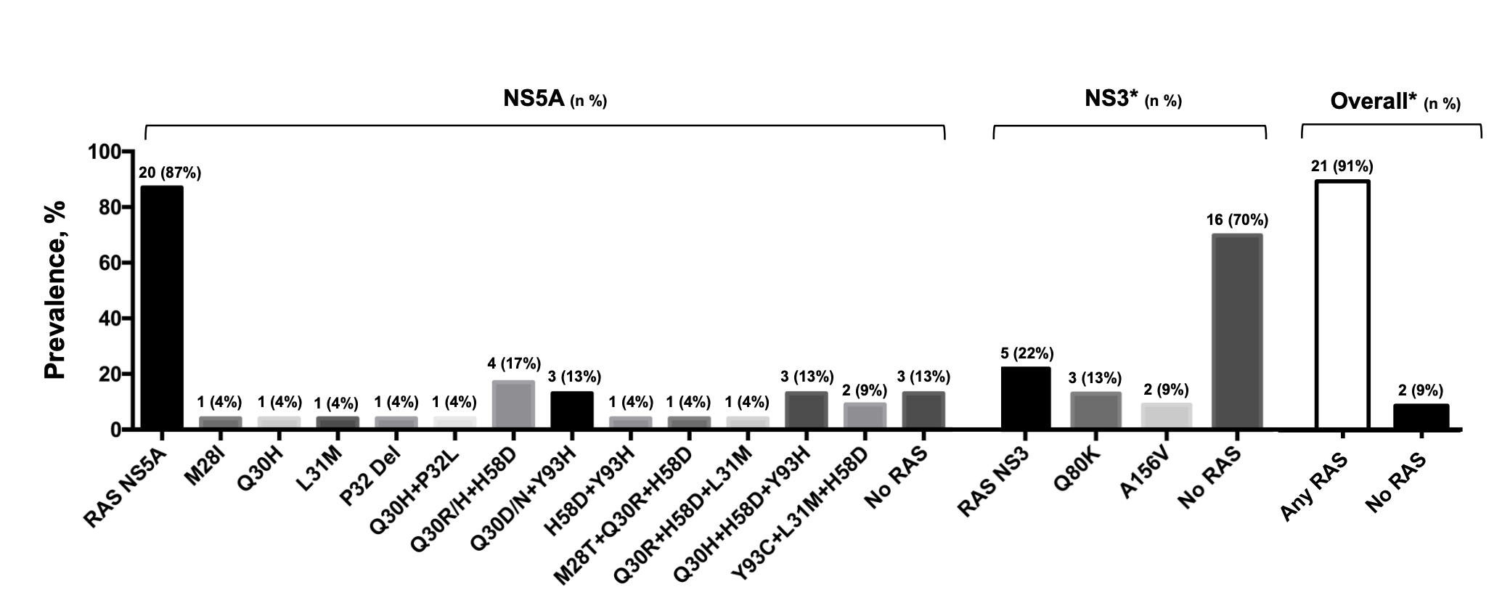
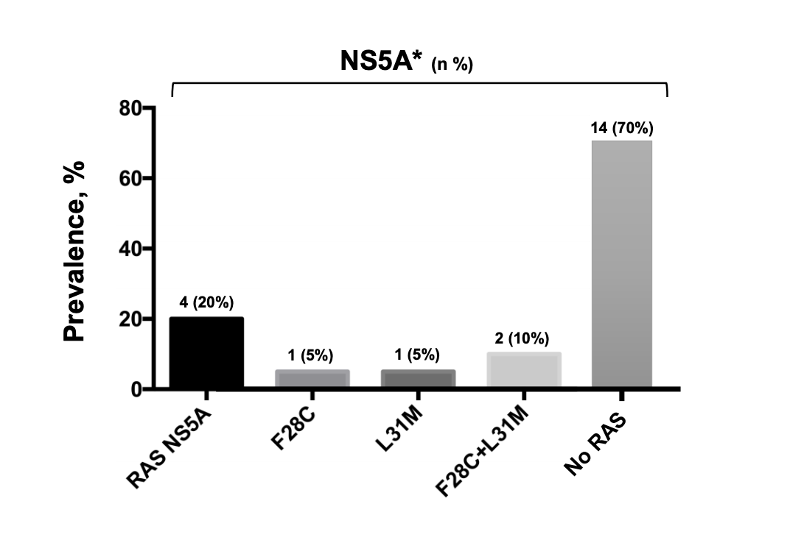
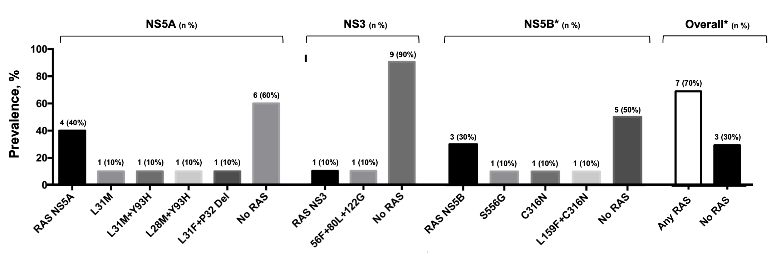
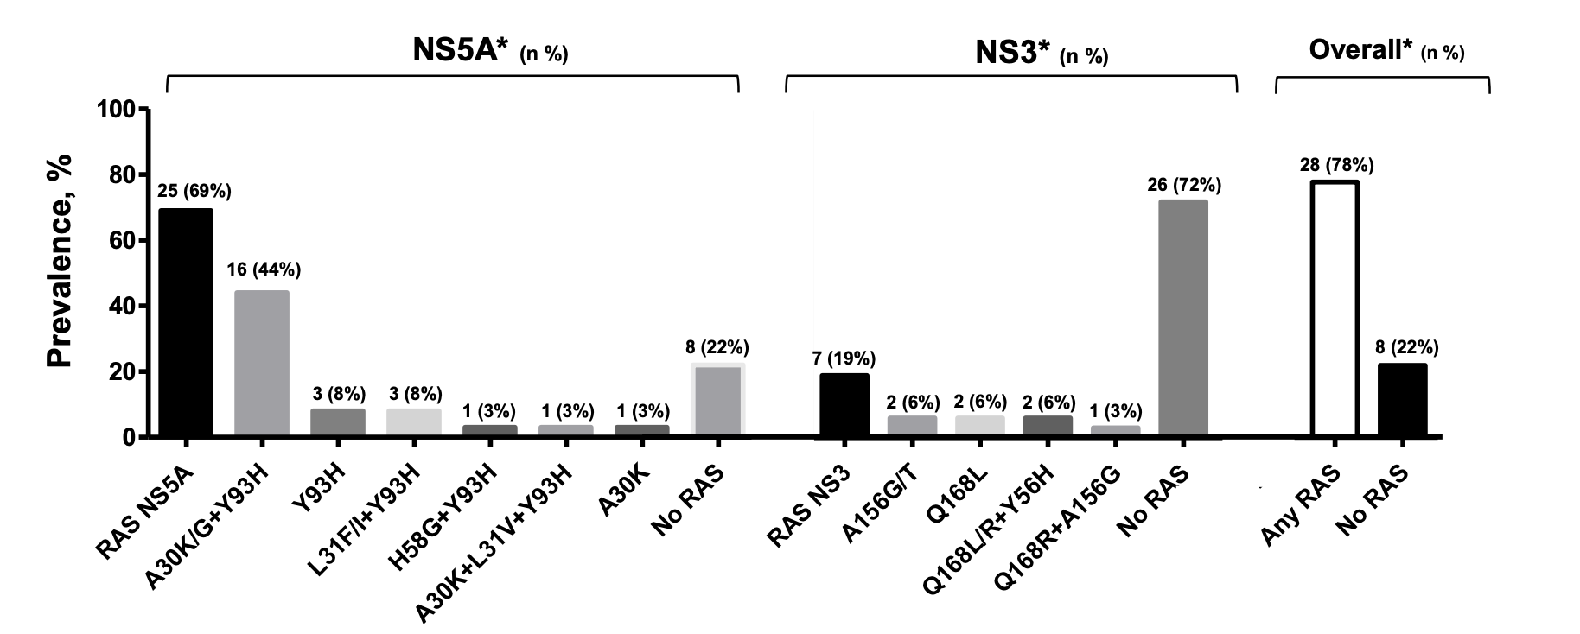
RASs at GP Failures
Genotype 1a
Genotype 2
Genotype 1b
Genotype 3

Slide 10
RASs in NS5A and NS3 after failing GP
Genotype | Any RAS | NS5A RASs | NS3 RASs | Without RASs | P
1a | 21/23, 91.3% | 20/23, 87.0% | 5/21, 23.8% | 2/23, 8.7% | Any RAS <0.05 NS5A RASs <0.05 NS3 RASs NS
1b | 5/10, 50.0% | 4/10, 10.0% | 1/10, 10.0% | 5/10, 50.0%
2a/2c | 4/18, 22.2% | 4/18, 22.2% | 0 | 14/18, 77.8%
3a | 27/34, 79.4% | 25/33, 75.8% | 7/33, 21.2% | 6/34, 17.6%
NS= not significant

Slide 11
GP retreatment outcome (n=56)
Most of the patients (52/56; 92.9%) were retreated with a combination of voxilaprevir, velpatasvir, and sofosbuvir
All patients except one (45/46; 97.8%) with evaluable SVR12 were successfully retreated.
The remaining individuals (n=4) were retreated with sofosbuvir and velpatasvir, with 75% SVR12.
Genotype | Post GP | Outcome | NS5A | NS3
1a | SOF/VEL | relapse | Q30R+H58D | WT
3a | SOF/VEL/VOX | relapse | A30K+Y93H | Y56H+Q168R
two patients died before SVR12 was available, one was lost to follow-up, and three had not yet reached the time of SVR12 evaluation.

Slide 12
VVS Cohort (n=40)
Male gender n, (%) | 30 (75)
Mean age | 59 (31-76)
HCV Genotype: n, (%)
Genotype 1a | 11 (28)
Genotype 1b | 9 (23)
Genotype 3a | 18 (45)
Genotype 3b | 1 (2)
Genotype 4d | 1 (2)
HIV coinfection | 6 (15)
HBsAg seroconversion | 6 (15)
Fibrosis stage (in pts. w/o cirrhosis)
F0/F1 | 2/7* (29)
F2 | 3/7* (42)
F3 | 2/7* (29)
Cirrhosis | 28 (70)
Child grade A | 20/23* (87)
Child grade B | 3/23* (13)
Child grade C | -
HCC | 10 (25)
Liver Transplantation | 4 (10)
*patients with info available

Slide 13
Pretreatment history of VVS failures
 | n (%)
P/R pretreatment ± BOC/TVR | 15 (38)
No. of previous DAA Treatments
One DAA treatment | 31 (78)
Two DAA treatments | 5 (12)
Three DAA treatments | 4 (10)
Overall pretreatment regimens
Any SOF-based regimen | 34 (85)
Any PI-based regimen | 12 (30)
NS5Ai-based regimen | 40 (100)
Treatment experience in pts. with one previous DAA treatment (n=31)
NS5Ai+SOF | 25 (81)
LDV/SOF | 7 (23)
DCV/SOF | 8 (26)
VEL/SOF | 10 (32)
PI+NS5Ai | 6 (19)
GLE/PIB | 4 (13)
PrOD+RBV | 2 (6)

Slide 14
VVS; RASs at baseline vs failure
Genotype 1a
Genotype 1b
Genotype 3

Slide 15
VVS retreatment and outcome (n=17).
HCV | RASs at VOX/VEL/SOF failure |  | Retreatment Regimen | Retreatment Duration (wks) | Retreatment Response
 | NS3 | NS5A
1a | Q80K | L31M | G/P+SOF | 12 | SVR12
1a | No RASs | M28V | G/P+SOF | 16 | Exitus
1b | Y56H, D168V | L31V, Y93H | G/P+SOF+RBV | 24 | SVR12
3a | No RASs | Y93H | G/P+SOF+RBV | 12 | SVR12
3a | Q168K | Y93H | G/P+SOF+RBV | 24 | SVR12
3a | No RASs | Y93H | G/P+SOF | 12 | SVR12
3a | No RASs | n.d. | G/P+SOF+RBV | 16 | Failure
3a | Q168K | Y93H | G/P+SOF+RBV | 16 | SVR12
1a | No RASs | Q30H, L31V, Y93H | G/P+SOF | 24 | pending
1a | No RASs | Q30R, L31M | G/P+SOF+RBV | 16 | pending
1b | Q80R | L31M, Y93H | G/P+SOF+RBV | 24 | pending
3a | Q168R | Y93H | G/P+SOF | 12 | pending
1b | No RASs | Y93H | G/P | 12 | SVR12
1b | No RASs | L31I | SOF/VEL/VOX | 24 | pending
3a | Q168R | A30K, Y93H | SOF/VEL/VOX+RBV | 24 | SVR12
3a | No RASs | No RASs | SOF/VEL/VOX | 24 | pending
3a | No RASs | Y93H | VEL/SOF+RBV | 24 | Failure

Slide 16
Conclusions
One-third of patients failed GP without resistance. RASs in NS5A were more prevalent than in NS3 and were frequently observed as dual and triple combination patterns, with a high impact on NS5A inhibitor activity, particularly in genotypes 1a and 3.
Retreatment of glecaprevir/pibrentasvir failures with voxilaprevir/velpatasvir/ sofosbuvir achieved viral suppression across all genotypes.
HCV GT3- and GT1a-infected patients with cirrhosis were frequent in the VVS difficult-to-retreat cohort, and rescue treatment with multiple targeted therapies was effective in the majority of patients.
The majority of patients with failure to a VOX/VEL/SOF retreatment did not select specific RAS patterns in NS3, NS5A or NS5B DAA target regions compared to baseline.

Slide 17
Federico Garcia/A de Salazar. Instituto Investigación Biosanitaria Ibs., Granada, Spain; GEHEP
Carole Seguin-Devaux. Luxembourg Institute of Health, Luxembourg
Francesca Ceccherini-Silberstein/CF Perno/
VC Di Maio. University of Rome Tor Vergata, Rome,
VIRONET
Orna Mor. Sheba Medical Center, Ramat-Gan, Israel
Vladimir Chulanov. Central Research Institute
of Epidemiology, Russia
Christoph Sarrazin/Julia Dietz. University Hospital Frankfurt,
Rolf Kaiser/Elena Knops. University Hospital Cologne,
Gary Wang/David Nelson/HCV TARGET. University of Florida College of Medicine, Gainesville, USA
Jean-Michel Pawlotsky/Stéphane Chevaliez/ Slim Fourati. Centre National de Réference des
Hépatites B, C et delta, ANRS- Hepather Dominique Salmon, Rafael Usubillaga. Paris Descartes University,
J Sfalcin/Fabien Fay. Laboratorio CIBIC, Rosario, Argentina
Mark Douglas. The Westmead Institute for Medical Research,
The University of Sydney, AustraliaTanya Applegate/Jason Grebely. The Kirby Institute, Sydney, Andrew Llyod/Chaturaka Rodrigo. University of New South Wales,
Mario Poljak/Maja Lunar. University of Ljubljana, Slovenia
Johan Lennerstrand/Midori Kjellin. Uppsala University, Uppsala, Sweden
Anita Howe/ Richard Harrigan/Hope Lapointe.
University of British Columbia,BC, Naveed Janjua/Mel Krajden, BC-CDC, British Columbia Edward Tam, LAIR Center, British Columbia Cruz Pereira. University of British Columbia, BC Rohit Pai. Univeristy of Bristish Columbia, BC, Jordan Feld. Toronto General Hospital. ON Alex Wong. University of Saskatchewan, SKSamuel Lee. University of Calgary, AB, Alnoor Ramji, University of British Columbia, BC,
Perpetuua Gomes. Hospital Egas Moniz, Lisbon and CiiEM, Almada, Portugal
Milosz Parczewski. Pomeranian Medical University, Szczecin, Poland
Charles Boucher/Stephanie Popping/ Rob de Knegt. Erasmus Medical Center, Rotterdam, Netherlands
Murat Sayan. Kocaeli University Faculty of Medicine,
Kocaeli, Turkey

Slide 18
Contact info
ceccherini@med.uniroma2.it
julia.dietz@em.uni-frankfurt.de
fegarcia@ugr.es
anita.howe@bccdc.ca

